Slide 1


Database Systems
Bushra
bushra@nu.edu.pk

Slide 2
Data Models
a collection of concepts that can be used to describe
the structure of a database (data types, constraints, relationships)
the operations for manipulating this structure
Most data models also include a set of basic operations for specifying retrievals and updates on the database.
Some data models allows a database designer to specify the dynamic aspect or behavior of a database application
Notes:
The data model presents conceptual representation using logical concepts, such as objects, their properties, and their interrelationships, that may be easier for most users to understand than computer storage concepts.
Hence, the data model hides storage and implementation details that are not of interest to most database users.
By structure of a database we mean the data types, relationships, and constraints that apply to the data.
Some data models allows the database designer to specify a set of valid user-defined operations that are allowed on the database objects.
In addition to the basic operations provided by the data model, it is becoming more common to include concepts in the data model to specify the dynamic aspect or behavior of a database application
This allows the database designer to specify a set of valid user-defined operations that are allowed on the database objects.
An example of a user-defined operation could be COMPUTE_GPA, which can be applied to a STUDENT object.
On the other hand, generic operations to insert, delete, modify, or retrieve any kind of object are often included in the basic data model operations.

Slide 3
Categories of Data Models
High-level or conceptual or semantic data models provide concepts that are close to the way many users perceive data
entities, attributes, and relationships based
Object based data model
Low-level or physical or internal data models provide concepts that describe the details of how data is stored on the computer storage media
represents information such as record formats, record orderings, and access paths
Notes:
Concepts provided by physical data models are generally meant for computer specialists, not for end users.

Slide 4
Categories of Data Models
Implementation or Representational data models provide concepts that may be easily understood by end users but that are not too far removed from the way data is organized in computer storage
these models are most frequently used in traditional commercial DBMSs (relational data model, the network and hierarchical models)
Self-describing data models combines the description of the data with the data values themselves.
These models include XML as well as many of the key-value stores and NOSQL systems
Notes:
Between these two extremes is a class of representational (or implementation) data models
hide many details of data storage on disk but can be implemented on a computer system directly.
Representational data models represent data by using record structures and hence are sometimes called record-based data models

Slide 5
Schemas
description of a database
It is specified during database design and is not expected to change frequently.
Schema Diagram: a displayed schema.
The diagram displays the structure of each record type
Each object in the schema—such as STUDENT or COURSE—a schema construct.

Slide 6
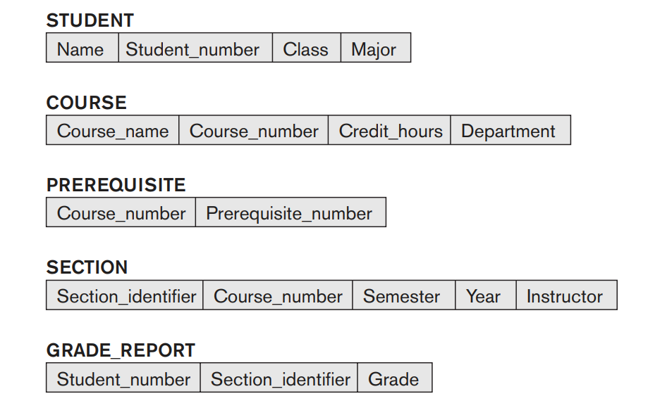
Schema Diagram
Notes:
A schema diagram displays only some aspects of a schema, such as the names of record types and data items, and some types of constraints
Other aspects are not specified in the schema diagram; for example, Figure 2.1 shows neither the data type of each data item nor the relationships among the various files.

Slide 7
Database State
Data in the database at a particular moment in time is called a database state or snapshot
current set of occurrences or instances in the database.
In a given database state, each schema construct has its own current set of instances;
Example, the STUDENT construct will contain the set of individual student entities (records) as its instances.
Every time we insert or delete a record or change the value of a data item in a record, we change one state of the database into another state.
Notes:
The actual data in a database may change quite frequently. For example, the database changes every time we add a new student or enter a new grade.

Slide 8

Database State
Notes:
In a given database state, each schema construct has its own current set of instances; for example, the STUDENT construct will contain the set of individual student entities (records) as its instances.

Slide 9
Database schema vs Database state
When we define a new database, we specify its database schema only to the DBMS.
the corresponding database state is the empty state with no data.
We get the initial state of the database when the database is first populated or loaded with the initial data.
From then on, every time an update operation is applied to the database, we get another database state.
The DBMS is partly responsible for ensuring that every state of the database is a valid state
The schema is sometimes called the intension, and a database state is called an extension of the schema.
Notes:
The DBMS is partly responsible for ensuring that every state of the database is a valid state—that is, a state that satisfies the structure and constraints specified in the schema.
Hence, specifying a correct schema to the DBMS is extremely important and the schema must be designed with utmost care.
The DBMS stores the descriptions of the schema constructs and constraints—also called the meta-data—in the DBMS catalog so that DBMS software can refer to the schema whenever it needs to.

Slide 10
Schema Evolution
Changes occasionally need to be applied to the schema as the application requirements change.
Example, adding the Date_of_birth to the STUDENT schema.
This is known as schema evolution.
Most modern DBMSs include some operations for schema evolution that can be applied while the database is operational.

Slide 11
Three schema architecture
Characteristics of Database Approach:
use of a catalog/data dictionary to store the database description (schema) to make it self-describing,
insulation of programs and data (program-data and program-operation independence), and
support of multiple user views.

Slide 12
Three schema architecture
was proposed to help achieve and visualize these characteristics
Goal: To separate the user applications from the physical database.
Schemas at different levels:
Internal level has an internal schema: describes the physical storage structure of the database.
The internal schema uses a physical data model and describes the complete details of data storage and access paths for the database.
Notes:
For our purposes, the fundamental point of these and later reports is the identification of three levels of abstraction, that is, three distinct levels at which data items can be described.
The way the DBMS and the operating system perceive the data is the internal level, where the data is actually stored using the data structures and file organizations
The internal level covers the physical implementation of the database to achieve optimal runtime performance and storage space utilization.
The internal level is concerned with such things as:
storage space allocation for data and indexes;
record descriptions for storage (with stored sizes for data items);
record placement;
data compression and data encryption techniques.
Below the internal level there is a physical level that may be managed by the operating system under the direction of the DBMS. However, the functions of the DBMS and the operating system at the physical level are not clear-cut and vary from system to system

Slide 13
Three schema architecture
Conceptual level has a conceptual schema: describes the structure of the whole database for a community of users.
The conceptual level hides the details of physical storage structures and concentrates on describing:
entities, data types, relationships, user operations, and constraints:
Usually, a representational data model is used to describe the conceptual schema when a database system is implemented.
implementation is often based on a conceptual schema design in a high-level data model.
Notes:
This level contains the logical structure of the entire database as seen by the DBA.
It is a complete view of the data requirements of the organization that is independent of any storage considerations
The conceptual level supports each external view, in that any data available to a user must be contained in, or derivable from, the conceptual level.
However, this level must not contain any storage-dependent details.
For instance, the description of an entity should contain only data types of attributes (for example, integer, real, character) and their length (such as the maximum number of digits or characters), but not any storage considerations, such as the number of bytes occupied.

Slide 14
Three schema architecture
External Level or View Level: includes a number of external schemas or user views.
Each external schema:
describes the part of the database that a particular user group is interested in and hides the rest of the database from that user group.
is typically implemented using a representational data model,
possibly based on an external schema design in a high-level conceptual data model
Notes:
The way users perceive the data is called the external level.
The users’ view of the database.
This level describes that part of the database that is relevant to each user
In addition, different views may have different representations of the same data.
For example, one user may view dates in the form (day, month, year), while another may view dates as (year, month, day).
Some views might include derived or calculated data: data not actually stored in the database as such, but created when needed.
For example, in the employee table, we may wish to view the age of a employee which can be calculated from the birthdate

Slide 15
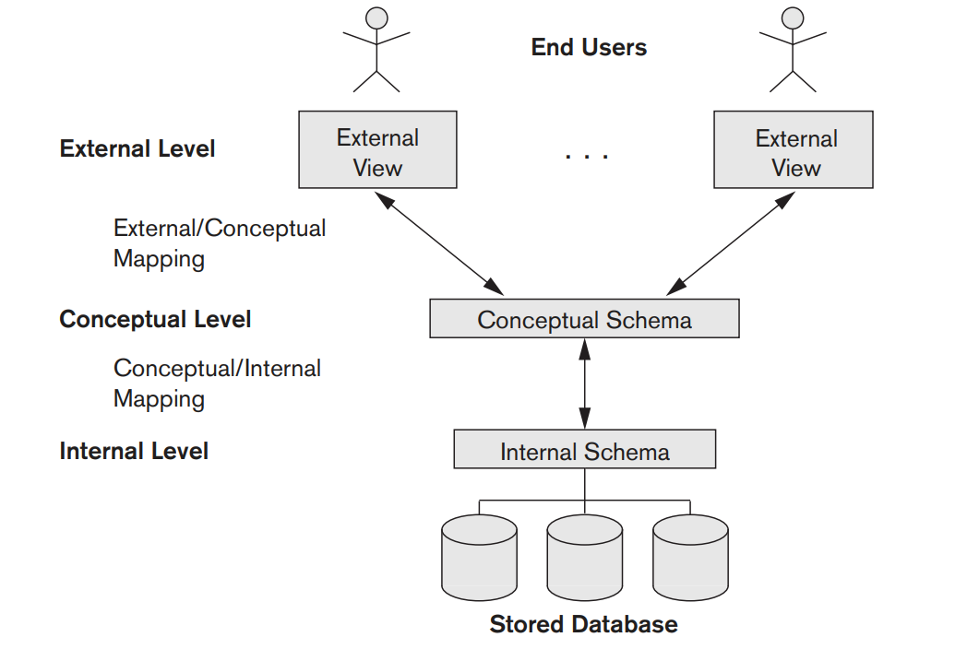
Three schema architecture
Notes:
The three-schema architecture is a convenient tool with which the user can visualize the schema levels in a database system.
Most DBMSs do not separate the three levels completely and explicitly, but they support the three-schema architecture to some extent.
Some older DBMSs may include physical-level details in the conceptual schema.
The three-level ANSI architecture has an important place in database technology development because it clearly separates the users’ external level, the database’s conceptual level, and the internal storage level for designing a database. It is very much applicable in the design of DBMSs, even today.
Notice that the three schemas are only descriptions of data; the actual data is stored at the physical level only.
In the three-schema architecture, each user group refers to its own external schema.
Hence, the DBMS must transform a request specified on an external schema into a request against the conceptual schema, and then into a request on the internal schema for processing over the stored database.
If the request is a database retrieval, the data extracted from the stored database must be reformatted to match the user’s external view.
The processes of transforming requests and results between levels are called mappings.
These mappings may be time-consuming, so some DBMSs—especially those that are meant to support small databases—do not support external views. Even in such systems, however, it is necessary to transform requests between the conceptual and internal levels.

Slide 16
Data Independence
the capacity to change the schema at one level of a database system without having to change the schema at the next higher level.
Types of data independence
Logical data independence
Physical data independence

Slide 17
Logical Data Independence
Capacity to change the conceptual schema without having to change external schemas or application programs.
We may change the conceptual schema
to expand the database (by adding a record type or data item),
to change constraints, or
to reduce the database (by removing a record type or data item).
Clearly, the users for whom the changes have been made need to be aware of them, but what is important is that other users should not be.
Notes:
Changes to the conceptual schema, such as the addition or removal of new entities, attributes, or relationships, should be possible without having to change existing external schemas or having to rewrite application programs.

Slide 18
Logical Data Independence
After the conceptual schema undergoes a logical reorganization, application programs that reference the external schema constructs must work as before.
Example:
add new columns to a certain relation, or split it into several subrelations,
as long as the user views still produce the same result as before, the users and applications that access the data through these views will not notice the change in the logical data model.
Notes:
Note that this is made possible since the SQL query over the user views(Subset of data coming from one or more tables in the database) is always first translated to an SQL query over the base tables (from which views data is derived).

Slide 19
Physical Data Independence
Capacity to change the internal schema without having to change the conceptual schema.
Changes to the internal schema may be needed because some physical files were reorganized
Example, providing an access path to improve retrieval speed of SECTION records should not require a query/program that accesses all sections offered in fall 2008 to be changed
although the query would be executed more efficiently by the DBMS by utilizing the new access path
Notes:
for example, by creating additional access structures—to improve the performance of retrieval or update.
If the same data as before remains in the database, we should not have to change the conceptual schema.
New access paths can be created from database management system utilities such as Database storage reorganization utility.

Slide 20
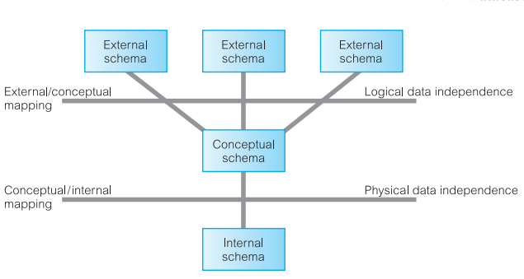
Data Independence
Notes:
Physical data independence exists in most databases and file environments where physical details, such as the exact location of data on disk, and hardware details of storage encoding, placement, compression, splitting, merging of reecords, and so on are hidden from the user.
Moreover we have utilities in DBMS using which can make changes to the storage requirements
Logical: The reason that it is hard to achieve is that it requires full support for views.
By full support I mean here both full support for queries and updates over views.
Because only if you have full support for both, you can completely avoid having to expose at any point the base tables(tables from which data is taken and placed in views which are shown to user) to users.
However, this full support for updates is rarely fully implemented, since updating a view which takes data from multiple tables is difficult.

Slide 21
Database Languages
In many DBMSs where no strict separation of levels of schemas is maintained,
Data definition language (DDL), is used by the DBA and by database designers to define both (conceptual and internal) schemas.
DDL compiler processes DDL statements
to identify descriptions of the schema constructs and
to store the schema description in the DBMS catalog
Notes:
Once the design of a database is completed and a DBMS is chosen to implement the database
the first step is to specify conceptual and internal schemas for the database and any mappings between the two.
DDL: A language that allows the DBA or user to describe and name the entities, attributes, and relationships required for the application, together with any associated integrity and security constraints. (these are all part of conceptual schema)

Slide 22
Database languages
Where a clear separation is maintained between the conceptual and internal levels:
the DDL is used to specify the conceptual schema only.
the Storage Definition Language (SDL), is used to specify the internal schema.
View definition language (VDL), to specify user views and their mappings to the conceptual schema,
Manipulations include retrieval, insertion, deletion, and modification of the data are performed using Data manipulation language (DML).
Notes:
In most relational DBMSs today, there is no specific language that performs the role of SDL.
For a true three-schema architecture, we would need a third language, the view definition language (VDL), to specify user views and their mappings to the conceptual schema,
but in most DBMSs the DDL is used to define both conceptual and external schemas.
At a theoretical level, we could identify different DDLs for each schema in the three-level architecture: namely, a DDL for the external schemas, a DDL for the conceptual schema, and a DDL for the internal schema.
However, in practice, there is one comprehensive DDL that allows specification of at least the external and conceptual schemas.

Slide 23
Database languages
In current DBMSs, the preceding types of languages are usually not considered distinct languages; rather, a comprehensive integrated language is used that includes constructs for conceptual schema definition, view definition, and data manipulation.
A typical example of a comprehensive database language is the SQL relational database language, which represents a combination of DDL, VDL, and DML, as well as statements for constraint specification, schema evolution, and many other features
Notes:
DCL stands for Data Control Language.
DCL is used to control user access in a database.
This command is related to the security issues.
Using DCL command, it allows or restricts the user from accessing data in database schema.
In current DBMSs, the preceding types of languages are usually not considered distinct languages; rather, a comprehensive integrated language is used that includes constructs for conceptual schema definition, view definition, and data manipulation. Storage definition is typically kept separate, since it is used for defining physical storage structures to fine-tune the performance of the database system, which is usually done by the DBA staff

Slide 24
Types of DML
Procedural DML | Non-Procedural DML
must be embedded in a general-purpose programming language. | can be used on its own to specify complex database operations concisely.
retrieves individual records or objects from the database and processes each separately also called record-at-a-time DMLs | can specify and retrieve many records in a single DML statement called set-at-a-time or set-oriented DMLs
specify what data is needed and exactly how to retrieve the data. | query often specifies which data to retrieve rather than how to retrieve it; are also called declarative.
Notes:
Procedural
This means that the user must express all the data access operations that are to be used by calling appropriate procedures to obtain the information required. Typically, such a procedural DML retrieves a record, processes it and, based on the results obtained by this processing, retrieves another record that would be processed similarly, and so on.
This process of retrievals continues until the data requested from the retrieval has been gathered. Typically, procedural DMLs are embedded in a high-level programming language that contains constructs to facilitate iteration and handle navigational logic.
Network and hierarchical DMLs are normally procedural
Non procedural
Nonprocedural DMLs allow the required data to be specified in a single retrieval or update statement.
With nonprocedural DMLs, the user specifies what data is required without specifying how it is to be obtained.
The DBMS translates a DML statement into one or more procedures that manipulate the required sets of records, which frees the user from having to know how data structures are internally implemented and what algorithms are required to retrieve and possibly transform the data, thus providing users with a considerable degree of data independence. Nonprocedural languages are also called declarative languages.
Relational DBMSs usually include some form of nonprocedural language for data manipulation, typically SQL or QBE (Query-By-Example).
In the latter case, DML statements must be identified within the program so that they can be extracted by a precompiler and processed by the DBMS.

Slide 25
Database languages
Whenever DML commands, whether high level or low level, are embedded in a general-purpose programming language, that language is called the host language and the DML is called the data sublanguage.
a high-level DML used in a standalone interactive manner is called a query language
In general, both retrieval and update commands of a high-level DML may be used interactively and are hence considered part of the query language.

Slide 26
DBMS Interfaces
Menu-based Interfaces for Web Clients or Browsing.
Apps for Mobile Devices.
Forms-based Interfaces
Graphical User Interfaces.
Natural Language Interfaces
Keyword-based Database Search.
Speech Input and Output.
Interfaces for different types of users

Slide 27
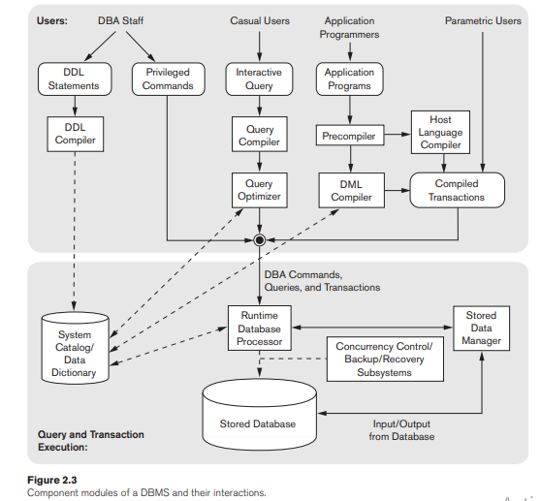
The Database System Environment
Notes:
A DBMS is a complex software system.
In this section we discuss the types of software components that constitute a DBMS and the types of computer system software with which the DBMS interacts.
DBMS Component Modules
The top part of the figure refers to the various users of the database environment and their interfaces.
The lower part shows the internal modules of the DBMS responsible for storage of data and processing of transactions.
The database and the DBMS catalog are usually stored on disk.
Access to the disk is controlled primarily by the operating system (OS), which schedules disk read/write.
Many DBMSs have their own buffer management module to schedule disk read/write, because management of buffer storage has a considerable effect on performance.
Reducing disk read/write improves performance considerably.
A higher-level stored data manager module of the DBMS controls access to DBMS information that is stored on disk, whether it is part of the database or the catalog.

Slide 28
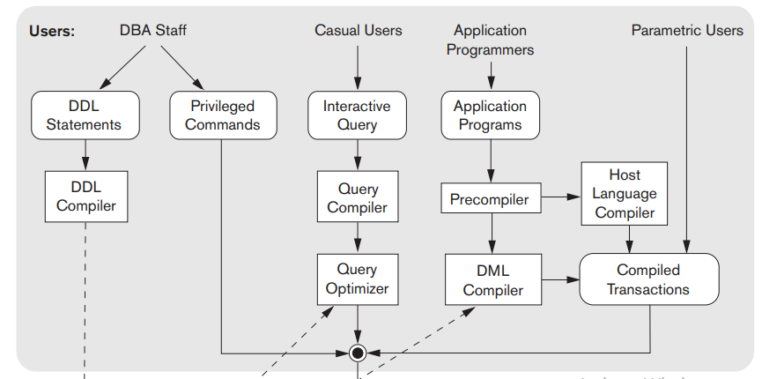
The Database System Environment
Notes:
It shows interfaces for the DBA staff, casual users who work with interactive interfaces to formulate queries, application programmers who create programs using some host programming languages, and parametric users who do data entry work by supplying parameters to predefined transactions.
The DBA staff works on defining the database and tuning it by making changes to its definition using the DDL and other privileged commands.
The DDL compiler processes schema definitions, specified in the DDL, and stores descriptions of the schemas (meta-data) in the DBMS catalog.
The catalog includes information such as the names and sizes of files, names and data types of data items, storage details of each file, mapping information among schemas, and constraints
Casual users and persons with occasional need for information from the database interact using the interactive query interface
These queries are parsed and validated for correctness of the query syntax, the names of files and data elements, and so on by a query compiler that compiles them into an internal form
This internal query is subjected to query optimization
query optimizer is concerned with the rearrangement and possible reordering of operations, elimination of redundancies, and use of efficient search algorithms during execution.
It consults the system catalog for statistical and other physical information about the stored data and generates executable code that performs the necessary operations for the query and makes calls on the runtime processor.
Application programmers write programs in host languages such as Java, C, or C++ that are submitted to a precompiler.
The precompiler extracts DML commands from an application program written in a host programming language.
These commands are sent to the DML compiler for compilation into object code for database access.
The rest of the program is sent to the host language compiler.
The object codes for the DML commands and the rest of the program are linked, forming a canned transaction whose executable code includes calls to the runtime database processor.
It is also becoming increasingly common to use scripting languages such as PHP and Python to write database programs.
Canned transactions are executed repeatedly by parametric users via PCs or mobile apps; these users simply supply the parameters to the transactions.
Each execution is considered to be a separate transaction.
An example is a bank payment transaction where the account number, payee, and amount may be supplied as parameters

Slide 29
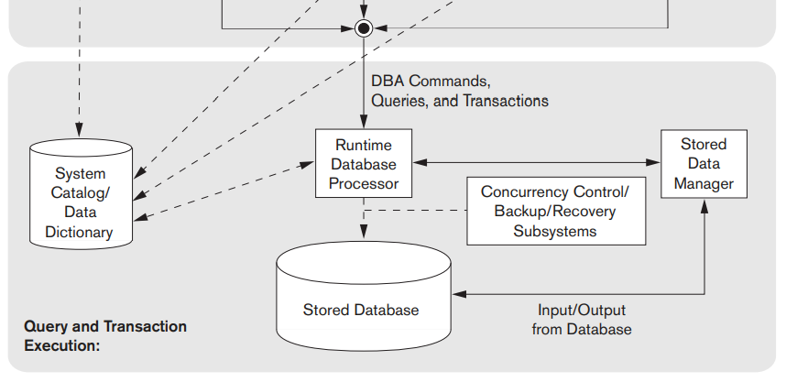
The Database System Environment
Top part
Notes:
the runtime database processor executes
the privileged commands,
the executable query plans, and
the canned transactions with runtime parameters.
It works with the system catalog and may update it with statistics.
It also works with the stored data manager, which in turn uses basic operating system services for carrying out low-level input/output (read/write) operations between the disk and main memory.
The runtime database processor handles other aspects of data transfer, such as management of buffers in the main memory.
Some DBMSs have their own buffer management module whereas others depend on the OS for buffer management.
We have shown concurrency control and backup and recovery systems separately as a module in this figure. They are integrated into the working of the runtime database processor for purposes of transaction management.
It is common to have the client program that accesses the DBMS running on a separate computer or device from the computer on which the database resides.
The former is called the client computer running DBMS client software and
the latter is called the database server.
In many cases, the client accesses a middle computer, called the application server, which in turn accesses the database server.
If the computer system is shared by many users, the OS will schedule DBMS disk access requests and DBMS processing along with other processes.
On the other hand, if the computer system is mainly dedicated to running the database server, the DBMS will control main memory buffering of disk pages.

Slide 30
Database System Utilities
DBMSs have database utilities that help the DBA manage the database system. Common utilities have the following types of functions:
Loading
used to load existing data files—such as text files or sequential files—into the database.
Backup
creates a backup copy of the database, usually by dumping the entire database onto tape or other mass storage medium.
Incremental backups are also often used
Notes:
In addition to possessing the software modules just described, most DBMSs have database utilities that help the DBA manage the database system.
Loading.
A loading utility is used to load existing data files—such as text files or sequential files—into the database.
Usually, the current (source) format of the data file and the desired (target) database file structure are specified to the utility, which then automatically reformats the data and stores it in the database.
With the proliferation of DBMSs, transferring data from one DBMS to another is becoming common in many organizations.
Some vendors offer conversion tools that generate the appropriate loading programs, given the existing source and target database storage descriptions (internal schemas).
Backup.
A backup utility creates a backup copy of the database, usually by dumping the entire database onto tape or other mass storage medium.
The backup copy can be used to restore the database in case of catastrophic disk failure.
Incremental backups are also often used, where only changes since the previous backup are recorded. Incremental backup is more complex, but saves storage space.

Slide 31
Database System Utilities
Database storage reorganization.
used to reorganize a set of database files into different file organizations
create new access paths to improve performance.
Performance monitoring.
monitors database usage and provides statistics to the DBA.
Other utilities may be available for sorting files, handling data compression, monitoring access by users, interfacing with the network, and performing other functions.
Notes:
Performance monitoring.
The DBA uses the statistics in making decisions such as whether or not to reorganize files or whether to add or drop indexes to improve performance. Other utilities may be available for sorting files, handling data compression, monitoring access by users, interfacing with the network, and performing other functions.

Slide 32
Tools, Application Environments, and Communications Facilities
Other tools are often available to database designers, users, and the DBMS. CASE tools are used in the design phase of database systems.
Expanded data dictionary (or data repository) system.
Application development environments, such as PowerBuilder (Sybase) or JBuilder (Borland), have been quite popular.
The DBMS also needs to interface with communications software, whose function is to allow users at locations remote from the database system site to access the database through computer terminals, workstations, or personal computers.
Notes:
Other tools are often available to database designers, users, and the DBMS.
CASE tools are used in the design phase of database systems.
Another tool that can be quite useful in large organizations is an expanded data dictionary (or data repository) system.
In addition to storing catalog information about schemas and constraints, the data dictionary stores other information, such as design decisions, usage standards, application program descriptions, and user information. Such a system is also called an information repository.
A data dictionary utility is similar to the DBMS catalog, but it includes a wider variety of information and is accessed mainly by users rather than by the DBMS software.
Application development environments, such as PowerBuilder (Sybase) or JBuilder (Borland), have been quite popular.
These systems provide an environment for developing database applications and include facilities that help in many facets of database systems, including database design, GUI development, querying and updating, and application program development.
The DBMS also needs to interface with communications software, whose function is to allow users at locations remote from the database system site to access the database through computer terminals, workstations, or personal computers.
These are connected to the database site through data communications hardware such as Internet routers, phone lines, long-haul networks, local networks, or satellite communication devices. Many commercial database systems have communication packages that work with the DBMS. The integrated DBMS and data communications system is called a DB/DC system.
In addition, some distributed DBMSs are physically distributed over multiple machines. In this case, communications networks are needed to connect the machines. These are often local area networks (LANs), but they can also be other types of networks.

Slide 33
Classification of Database Management Systems
Based on Data Models: main criterion for classifying DBMSs
Relational
represents a database as a collection of tables, where each table can be stored as a separate file.
main data model used in many current commercial DBMSs
Object
defines a database in terms of objects, their properties, and their operations
Object-relational
Relational DBMSs have been extending their models to incorporate object database concepts and other capabilities
Notes:
main criterion for classifying DBMSs: the data model.
In ORD, the basic approach is based on RDB, since the data is stored in a traditional database and manipulated and accessed using queries written in a query language like SQL. However, ORD also showcases an object-oriented characteristic in that the database is considered an object store, usually for software that is written in an object-oriented programming language.

Slide 34
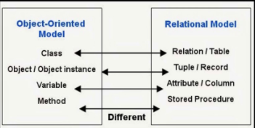
Classification of Database Management Systems
Based on Data Models
Notes:
main criterion for classifying DBMSs: the data model.

Slide 35
Classification of Database Management Systems
Based on Data Models
Recently, so-called big data systems, also known as key-value storage systems and NOSQL systems, use various data models
Key-value
associates a unique key with each value (which can be a record or object) and provides very fast access to a value given its key.
Document data model
based on JSON (Java Script Object Notation) and stores the data as documents, which somewhat resemble complex objects
Graph data model
stores objects as graph nodes and relationships among objects as directed graph edges.

Slide 36
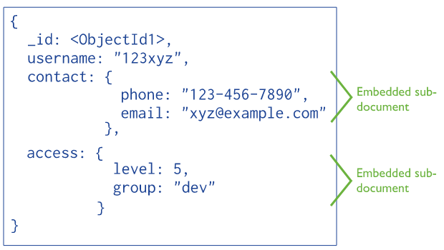
Classification of Database Management Systems
Document data model

Slide 37
Classification of Database Management Systems
Based on Data Models
Recently, so-called big data systems, also known as key-value storage systems and NOSQL systems, use various data models
column-based data models
store the columns of rows clustered on disk pages for fast access and allow multiple versions of the data.
legacy applications
hierarchical model
represents data as hierarchical tree structures. Each hierarchy represents a number of related records
Network model
Notes:
A column-oriented DBMS or columnar DBMS is a database management system (DBMS) that stores data tables by column rather than by row.
The network databases like CODSASYL are still more or less based on a hierarchical data model, thinking in terms of parent-child (or owner-member in CODASYL terminology) relationships. This also means that in network database you can't relate arbitrary records to each other, which makes it hard to work with graph-oriented datasets. For example, you may use a graph database to analyze what relationships exist between entities.

Slide 38
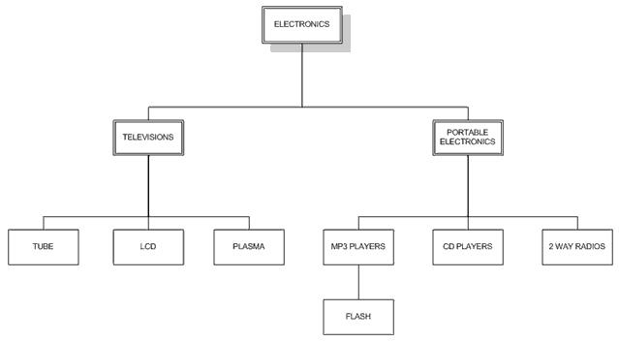
Classification of Database Management Systems
Notes:
Hierarchical model

Slide 39
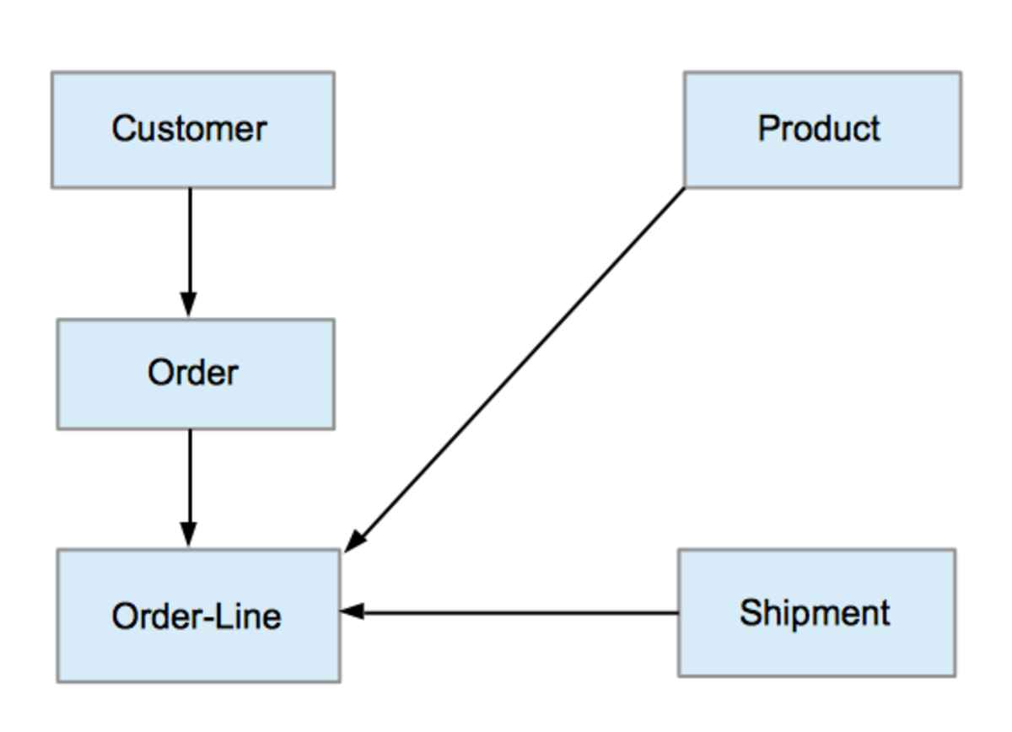
Classification of Database Management Systems
Notes:
Network model

Slide 40
Classification of Database Management Systems
Based on number of users supported by the system
Single-user systems support only one user at a time and are mostly used with PCs.
Multiuser systems, which include the majority of DBMSs, support concurrent multiple users.

Slide 41
Classification of Database Management Systems
Based on number of sites over which the database is distributed
centralized if the data is stored at a single computer site.
can support multiple users, but the DBMS and the database reside totally at a single computer site.
distributed DBMS (DDBMS) can have the actual database and DBMS software distributed over many sites connected by a computer network.
Notes:
Big data systems are often massively distributed, with hundreds of sites.
The data is often replicated on multiple sites so that failure of a site will not make some data unavailable.

Slide 42
Classification of Database Management Systems
Based on number of sites over which the database is distributed
Homogeneous DDBMSs use the same DBMS software at all the sites,
Heterogeneous DDBMSs can use different DBMS software at each site.
Federated DBMS (or multidatabase system), in which the participating DBMSs are loosely coupled and have a degree of local autonomy
Notes:
It is also possible to develop middleware software to access several autonomous preexisting databases stored under heterogeneous DBMSs.
This leads to a federated DBMS (or multidatabase system), in which the participating DBMSs are loosely coupled and have a degree of local autonomy
A federated database system is a type of meta-database management system (DBMS),
which transparently integrates multiple autonomous database systems into a single federated database.
The constituent databases are interconnected via a computer network and may be geographically decentralized.

Slide 43
Classification of Database Management Systems
Based on cost
open source (free) DBMS products like MySQL and PostgreSQL that are supported by third-party vendors with additional services.
sold in the form of licenses
site licenses allow unlimited use of the database system with any number of copies running at the customer site.
another type of license limits the number of concurrent users or the number of user seats at a location.

Slide 44
Classification of Database Management Systems
Based on types of access path options for storing files
One well-known family of DBMSs is based on inverted file structures
Based on performance
performance is a primary consideration,
a special-purpose DBMS can be designed and built for a specific application
Many airline reservations and telephone directory systems developed in the past are special-purpose DBMSs.
Notes:
a special-purpose DBMS can be designed and built for a specific application; such a system cannot be used for other applications without major changes.
These fall into the category of online transaction processing (OLTP) systems, which must support a large number of concurrent transactions without imposing excessive delays.

